Slide 1
LLMs in Action: Developing a COM AI Player for an Interactive Tic-Tac-Toe Game using OpenAI Developer API
Lesson 1: Large Language Models
Priscilla Emasoga
COM3550 Undergraduate Ambassadors Scheme
University of Sheffield

Slide 2
Overview
Motivation
A Brief History of Artificial Intelligence (AI)
Machine Learning, Deep Learning and Generative AI
What are LLMs?
How LLMs Work
Applications
Limitations
Aside: Careers in AI
COM3550, Undergraduate Ambassadors Scheme
1/14

Slide 3
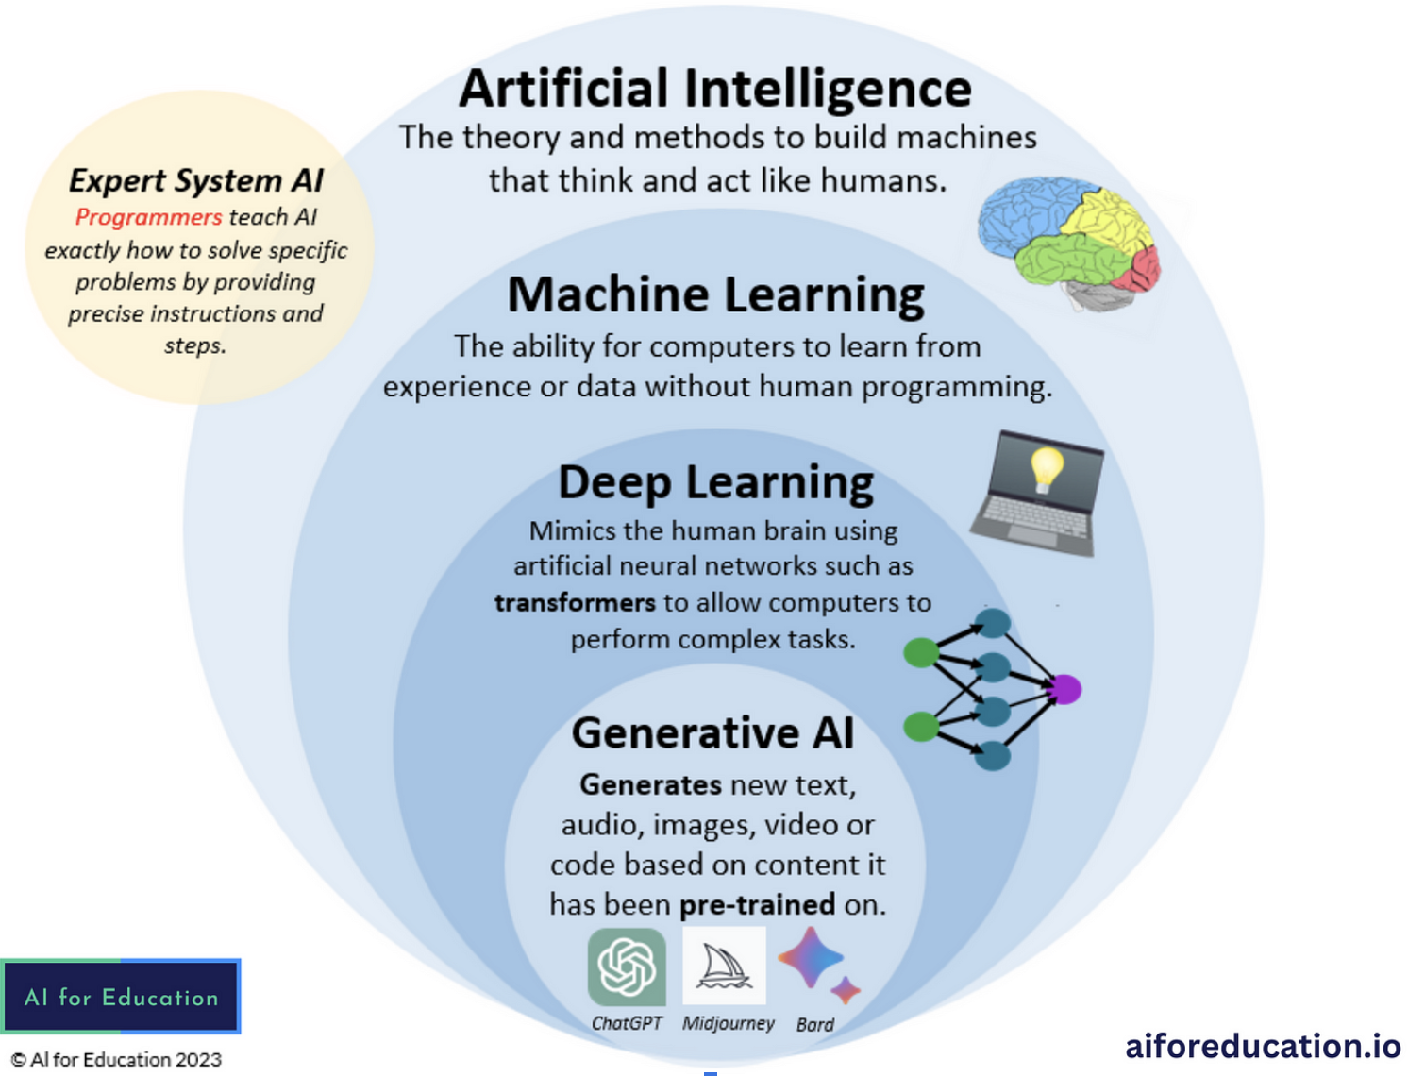
Motivation: A brief history in AI
The powerful language models we have today builds from decades of research in AI
1950s: 1950s – Alan Turing proposes the Turing Test, marking the birth of AI.
1960s-1970s: Rule-based systems and expert systems emerge (e.g., ELIZA, DENDRAL).
1980s–2000s: Introduction of early machine learning methods.
2010s: Deep learning revolutionises AI with CNNs, transformers, etc
2020s: Rise of Generative AI (LLMs, DALL·E, ChatGPT) and AGI research.
COM3550, Undergraduate Ambassadors Scheme
2/14

Slide 4
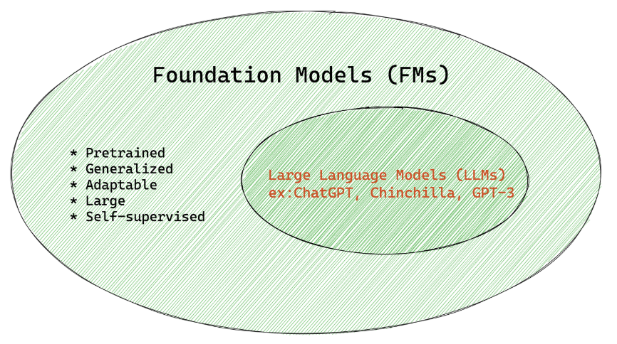
What are LLMs?
LLMs are a subset of Foundation Models (FM)
Deep learning models trained on broad datasets
Used across multiple domains (text, vision, speech, etc.)
Based on the transformer architecture
Serve as a base for fine-tuning on specific tasks
LLMs are designed specifically to understand and generate human-like text
“All llms are foundation models but not all foundation models are LLMs”
COM3550, Undergraduate Ambassadors Scheme
3/14

Slide 5
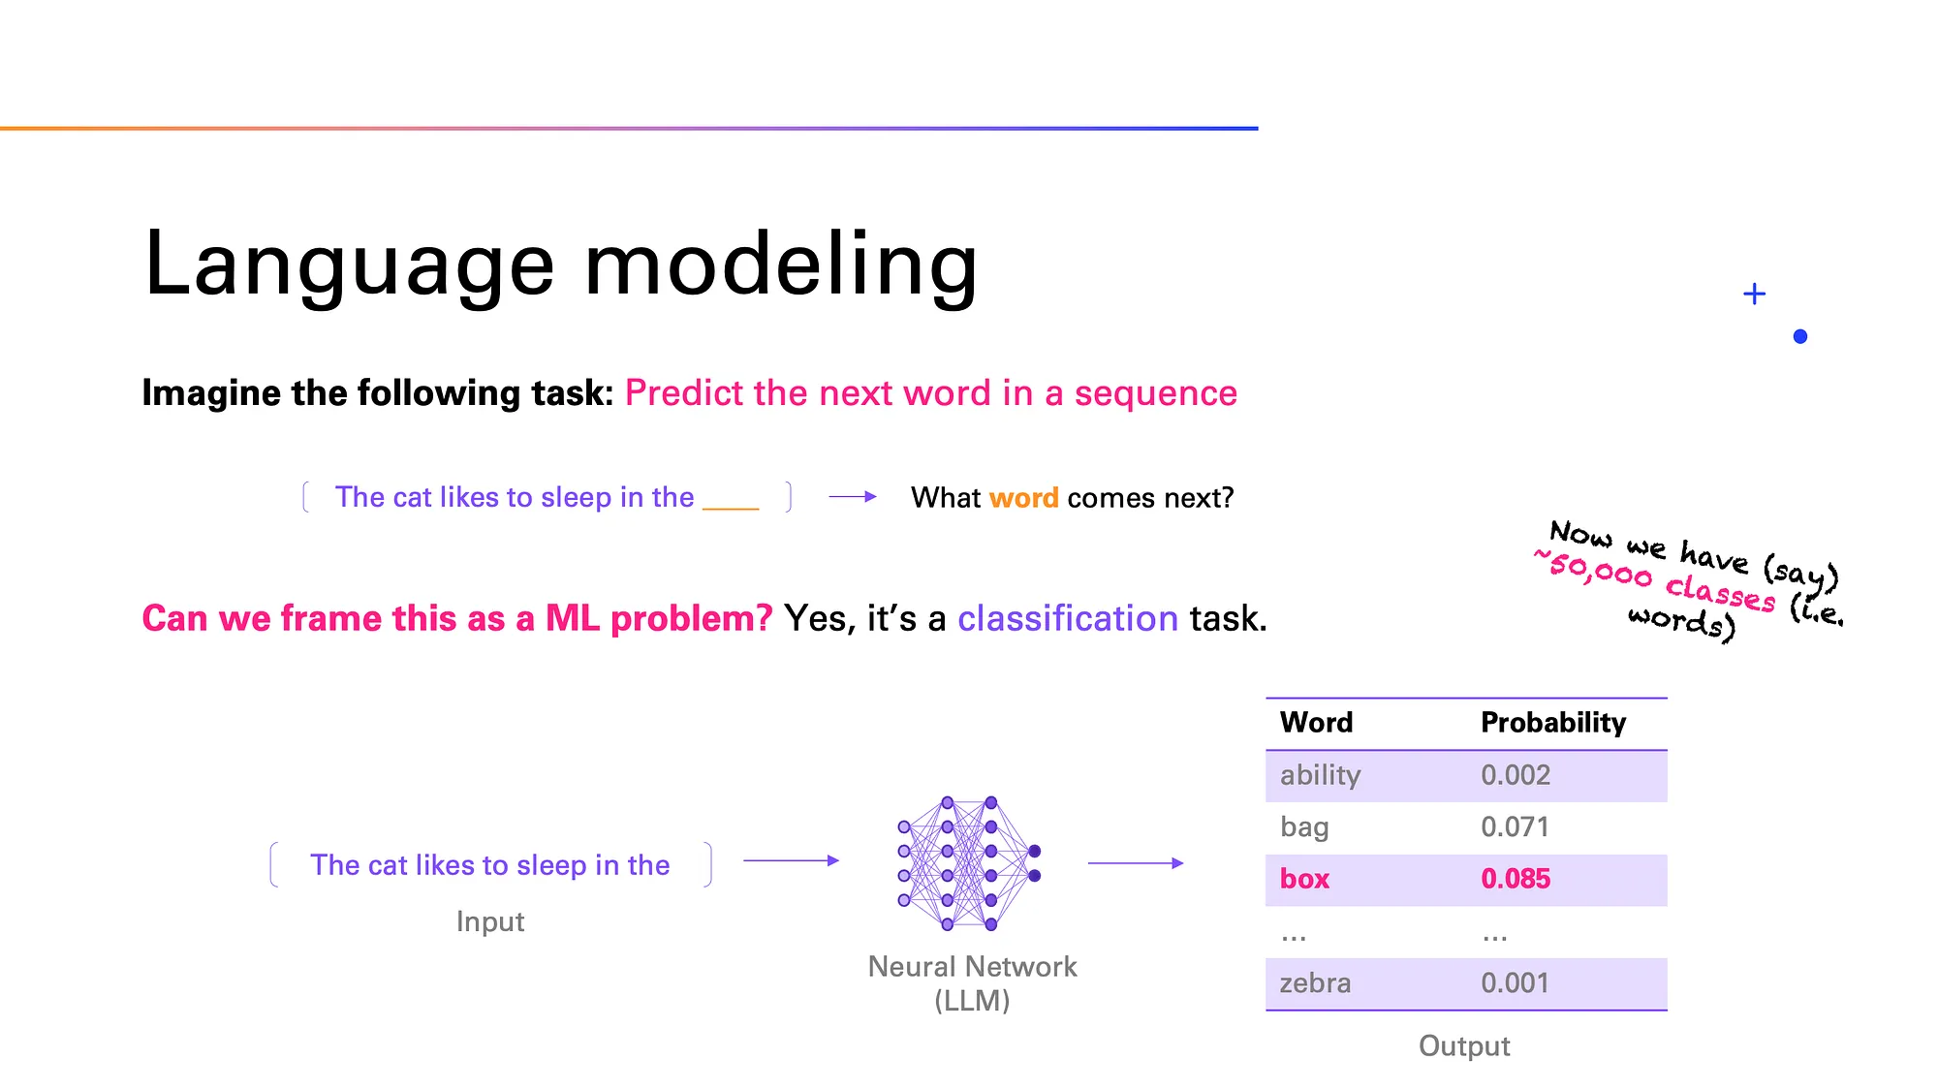
How LLMs Work
Image from: https://medium.com/data-science-at-microsoft/how-large-language-models-work-91c362f5b78f
COM3550, Undergraduate Ambassadors Scheme
4/14

Slide 6
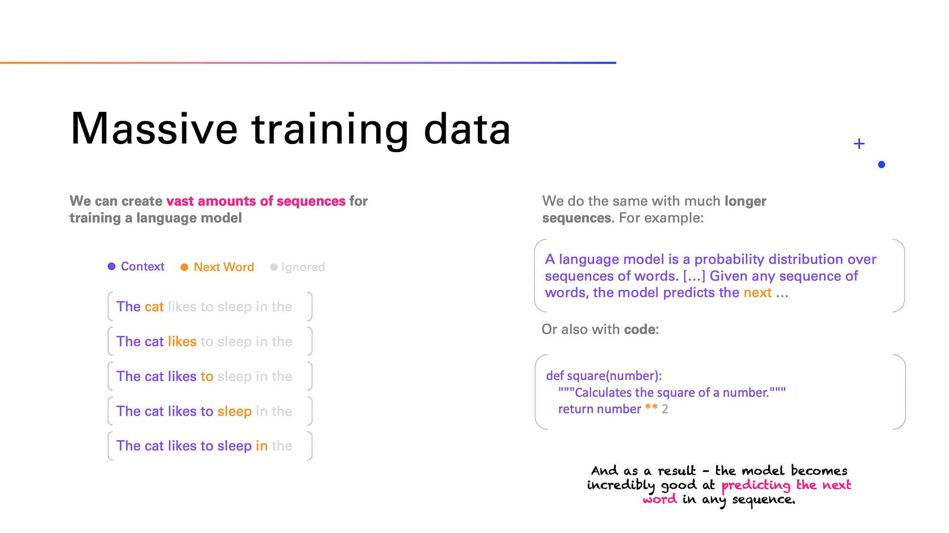
How LLMs Work
Image from: https://medium.com/data-science-at-microsoft/how-large-language-models-work-91c362f5b78f
COM3550, Undergraduate Ambassadors Scheme
5/14

Slide 7
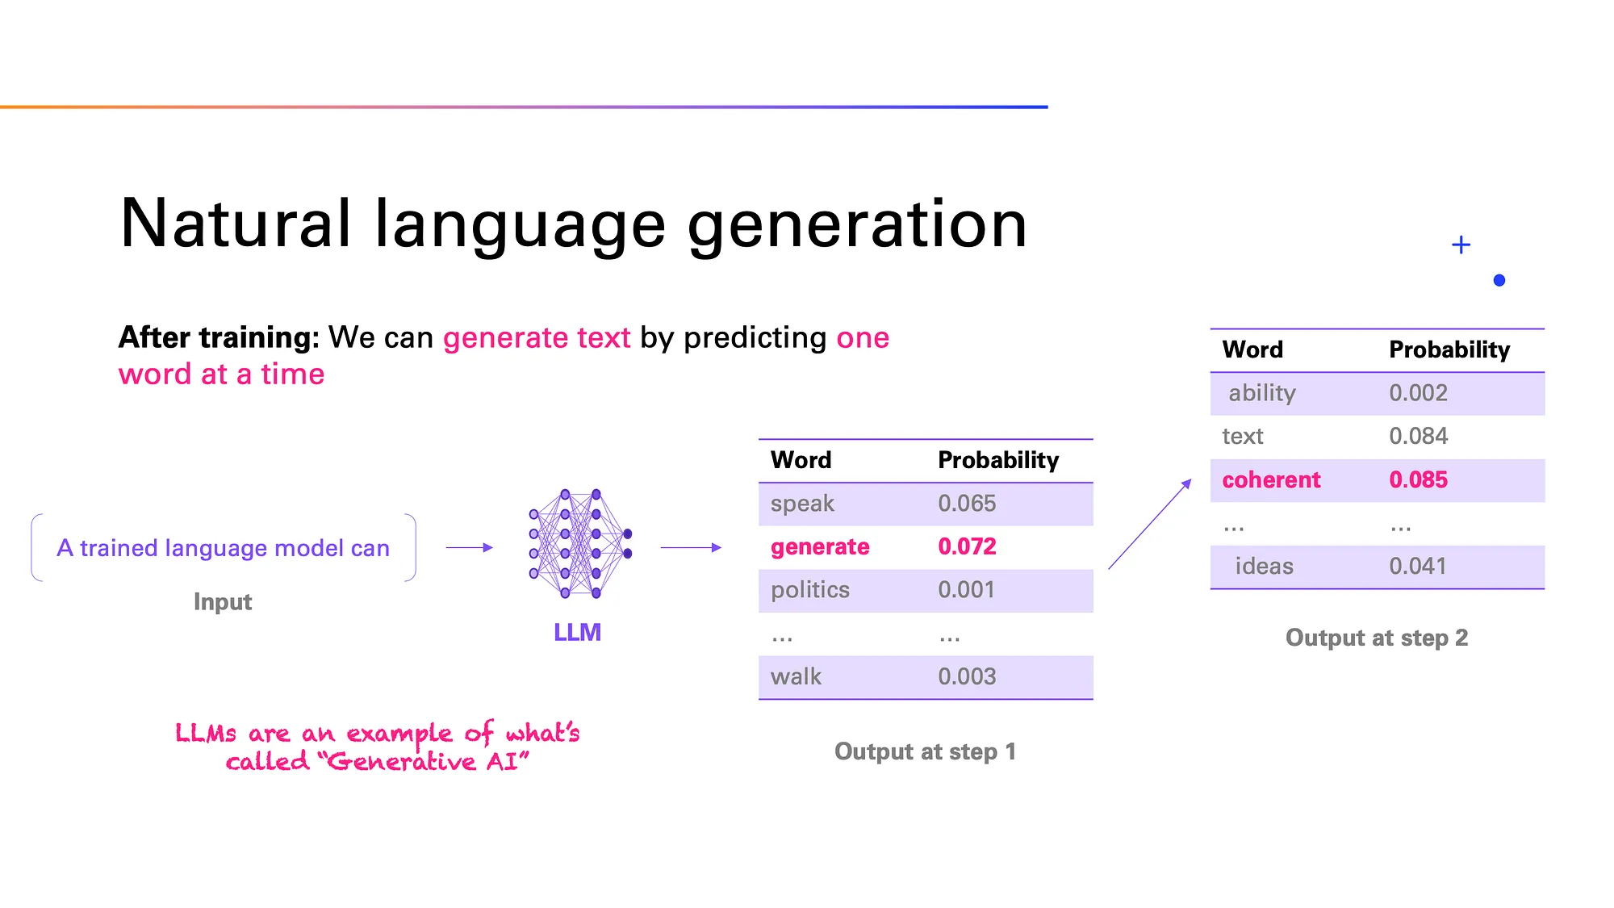
How LLMs Work
Image from: https://medium.com/data-science-at-microsoft/how-large-language-models-work-91c362f5b78f
COM3550, Undergraduate Ambassadors Scheme
6/14

Slide 8





Popular GenAI Models
Company | Popular Models
 | GPT, Codex, DALL-E, Sora
 | Gemini, BERT variants, Veo 2
 | LLaMA
 | R1
 | Claude
COM3550, Undergraduate Ambassadors Scheme
7/14

Slide 9

Text-to-Video Models: Model Comparison
Veo 2 (Google) vs Sora (OpenAI)
COM3550, Undergraduate Ambassadors Scheme
8/14

Slide 10



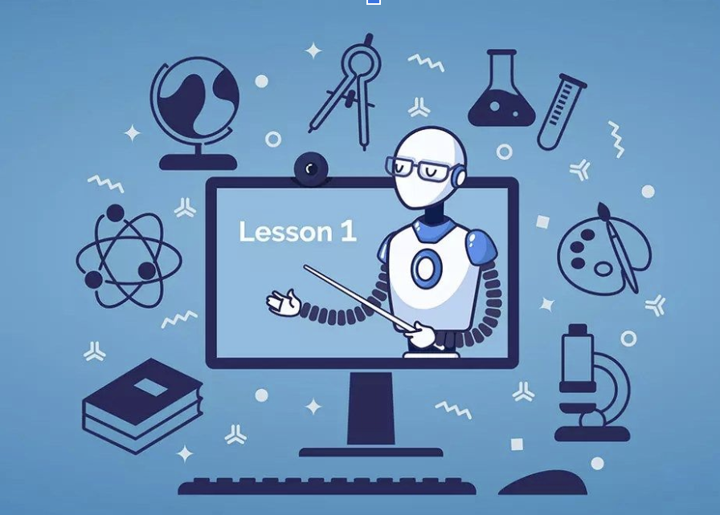

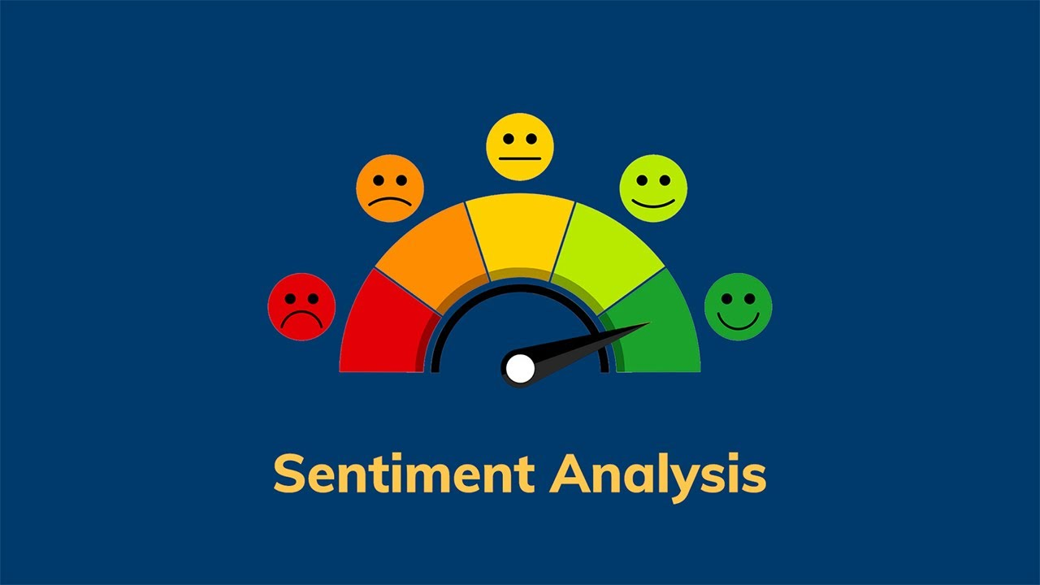
Business Applications of LLMs
Customer Service Content Creation Software Development
Education Data Analysis Sentiment Analysis
COM3550, Undergraduate Ambassadors Scheme
9/14

Slide 11
Limitations of LLMs
Hallucinations
May generate plausible but inaccurate information
Data bias
May produce biased or stereotypical content
Often a product of datasets containing bias information
High computational costs
Significant resources required for training and deployment
Ethical Implications
Privacy concerns regarding data usage and storage
Data Security risks
e.g “DeepSeek data leak exposes 1 million sensitive records” ( Forbes, 2025)
Caused by misconfigured cloud storage instance lacking access control
COM3550, Undergraduate Ambassadors Scheme
10/14

Slide 12
Aside: Careers in Artificial Intelligence

Slide 13
Top AI Jobs in the UK (2025)
Career Path | Description | Average Salary
Machine Learning Engineer | Designs and develops algorithms enabling machines to learn from data. | £59,000
AI Engineer | Creates intelligent systems that perform human-like tasks. | £52,000
Computer Vision Engineer | Develops systems that interpret and process visual information. | £57,884
NLP Engineer | Builds systems allowing computers to understand and generate human language. | £53,000
Data Scientist | Analyzes large datasets to extract meaningful insights. | £51,761
Robotics Engineer | Designs and builds robotic systems. | £46,025
Deep Learning Engineer | Develops advanced neural networks for deep learning applications. | £58,000
AI Product Manager | Oversees development and management of AI-driven products. | £64,713
AI Consultant | Provides strategic advice on AI integration. | £50,000
Generative AI Engineer | Works on generative AI models, a rapidly emerging field. | £72,000
Data from: www.accesscreative.ac.uk, www.glassdoor.co.uk
COM3550, Undergraduate Ambassadors Scheme
12/14

Slide 14
Summary
LLMs are foundation models trained on large datasets to generate human-like text.
They use deep learning architectures like transformers for contextual understanding.
During text generation, they predict the next word token-by-token based on learned probabilities.
Applications:
Used in customer service, content creation, software development, education, and data analysis.
Limitations:
Prone to hallucinations, data bias, high computational costs, ethical concerns, and security risks.
COM3550, Undergraduate Ambassadors Scheme
13/14

Slide 15
Questions?
COM3550, Undergraduate Ambassadors Scheme
14/14

